Slide 1
CAPITAL BUDGETING
Financing and investment of funds are two crucial financial functions. The investment of funds also termed as capital budgeting. It requires a number of decisions to be taken in a situation, in which funds are invested and benefits are expected over a long period.
Capital budgeting means planning for capital assets. The capital budgeting decision means a decision as to whether or not money should be invested in long-term projects such as the setting up of a factory or installing a machinery or creating additional capacities to manufacture a part, which at present may be purchased from outside. It includes a financial analysis of the various proposals regarding capital expenditure to evaluate their impact on financial condition of the company and to choose the best out of the various alternatives.

Slide 2
DEFINITION
According to EE Nemmers, “Capital budgeting or capital management may be defined as the process of determining which investment or allocation of long-term funds are to be made by an enterprise.”
According to Charles T Horngreen, “Capital budgeting is long-term planning for making and financing proposed capital outlays.”

Slide 3
Importance of Capital Budgeting Decision
Capital budgeting decisions should be taken after careful analyse and review. The importance of capital budgeting can be understood from the following points-
Cost- Initial investment is substantial. Hence, commitment of resources should be made properly.
Time- The effect of decision is known only in the near future and not immediately.
Irreversibility- Decisions are irreversible and commitment should be made, on proper evaluation.
Complexity-Decisions are based on forecasting of future events and inflows. Quantification of future events involves application of statistical and probabilistic techniques careful judgement and application of mind is necessary.

Slide 4
Types of Capital Budgeting Decision
Capital budgeting decisions are classified in two ways.
On the basis of ‘firm's existence’
On the basis of ‘decision situation’

Slide 5
Based on Firm's Existence
A. Cost Reduction Decision
These decisions focus on reduction of operating cost and improving efficiency. They can be sub-classified into two parts-
Replacement Decisions-The main objective to replacement is to improve operating efficiency and reduce costs which lead to increased profit, but the firm's revenue may remain unchanged.
Modernization Decisions- As the time passes, assets become outdated and obsolete with technological changes. The firm must decide to replace these assets with new assets, so that firm may launch better product and operate more economically.

Slide 6
B. Revenue Expansion Decision
These decisions focus on improving sales product lines, improved versions of products etc. These are sub-classified into two parts-
Expansion Decisions-To add capacity to existing product lines to meet increased demand. To improve production facilities and to increase market share of existing products.
Diversification Decisions-To diversify and enter into new product lines, venture into new markets to reduce business risk by dealing in different products and operating in different markets.

Slide 7
Based on Nature of Decision
A. Mutually Exclusive Decisions
Decisions are said to be mutually exclusive, if two or more alternative proposals are such that the acceptance of one proposal will exclude acceptance of the other alternative proposals.
B. Accept-Reject Decisions
These are opposite to mutually exclusive decisions. The accept-reject decision occur when proposals are independent and do not compete with each other. The firm may accept or reject a proposal on the basis of a minimum return on required investments.

Slide 8
C. Contingent Decisions
These are dependent proposals. The investment in one proposal require investment in one or more other proposals.

Slide 9
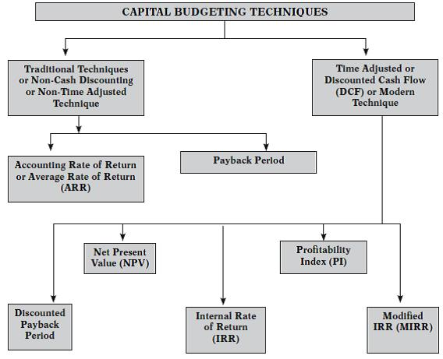

Slide 10
Conventional or Traditional Techniques of Capital Budgeting
Payback Period
Payback period represents the time period required for complete recovery of the initial investment in the project. It is the period within which the total cash inflows from the project equals to the cost of project. The lower the payback, the better it is, since initial investment is recouped faster.

Slide 11
Computation of Simple Payback Period
Determine the total outflow of the project (Initial Investment).
Determine the Cash Inflow After Taxes (CFAT) for each year.
Determine the Cumulative CFAT at the end of every year.
Determine the year in which cumulative CFAT exceeds initial investment.
Compute payback period as under
= Initial Investment/CFAT per annum.
Accept, if payback period is less than maximum or benchmark period, else reject the project.

Slide 12
advantages
Simple and easy.
It gives indication of Liquidity.
It deals with risk also, the project with a shorter payback period will be less risky as compared to project with longer payback period as the cash inflow which arise further in future will be less certain and hence more risky.

Slide 13
Disadvantages
It ignores what happens after the initial investment is recovered.
It ignores the time value of money.
It ignores the Salvage value.
This is only the method of capital recovery and not to know the profit . Only capital recovery is not enough because from economic point of view profit is the main indicator.

Slide 14
THANK YOU

